Slide 1
3. Setting Up Development Environment
Training Workshop for IONIC framework

Slide 2
Objectives
Take a look at the installation tool for front-end and back-end
Install the front-end tool
Create and test the Ionic project and Node server

Slide 3
Contents
3.1 Installation Tool List
3.1.1 Front-end
3.1.1.1 Ionic Framework
3.1.1.2 AngularJS
3.1.1.3 CORDOVA
3.1.2 Back-end
3.1.2.1 Node.js
3.1.2.2 Express.js
3.1.2.3 MongoDB

Slide 4
Contents
3.2 Visual Studio Code
3.2.1 HTML Snippets
3.2.2 Angular 2 TypeScript Emmet
3.2.3 Angular 2, 4 upcoming latest TypeScript HTML Snippets
3.2.4 TypeScript Importer

Slide 5
Contents
3.3 Back-end Tool Installation
3.3.1 Node.js
3.3.2 MongoDB
3.4 Front-end Tool Installation
3.4.1 Ionic Framework (CLI and CORDOVA)
3.5 Testing
3.5.1 Creating Ionic Project
3.5.2 Creating Node Server

Slide 6

3.1 Installation Tool List 3.1.1 Front-end
3.1.1.1 Ionic Framework
Open source SDK that enables developers to build mobile apps using web technologies
Use Node.js and AngularJS for creating hybrid apps
Use CORDOVA for device

Slide 7
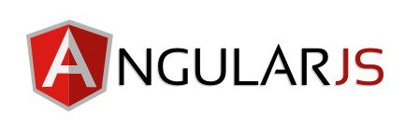
3.1 Installation Tool List 3.1.1 Front-end
3.1.1.2 AngularJS
client-side MVC/MVVM framework built in JavaScript
Reduce the amount of code you write in JavaScript
Bidirectional binding is possible
Clear separation of development areas such as HTML, CSS, and logic

Slide 8
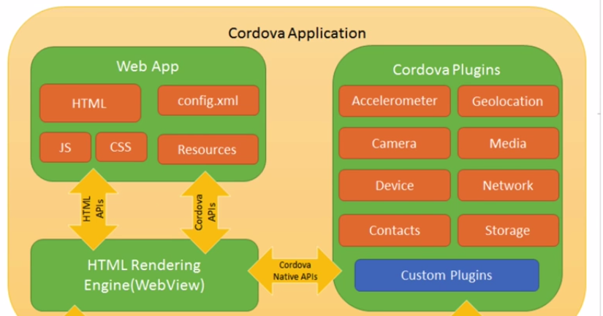
3.1 Installation Tool List 3.1.1 Front-end
3.1.1.3 CORDOVA
Plug-in used to implement hardware-based features ex) camera, device, storage etc
(https://www.youtube.com/watch?v=dMHU9c-JwpI)

Slide 9
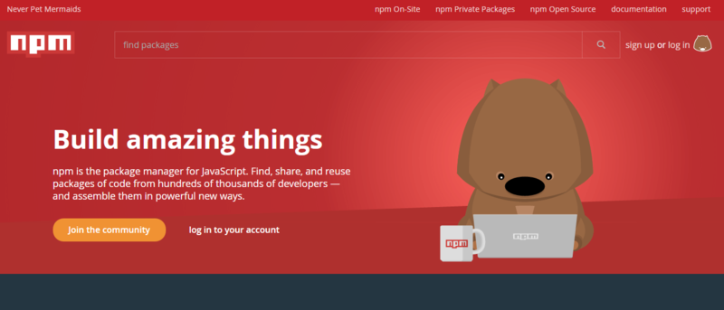
3.1 Installation Tool List 3.1.2 Back-end
3.1.2.1 Node.js
JavaScript runtime built on Chrome’s V8 JavaScript engine
Can implement the backend side like a web server in JavaScript
Node.js is installed to use node package module

Slide 10
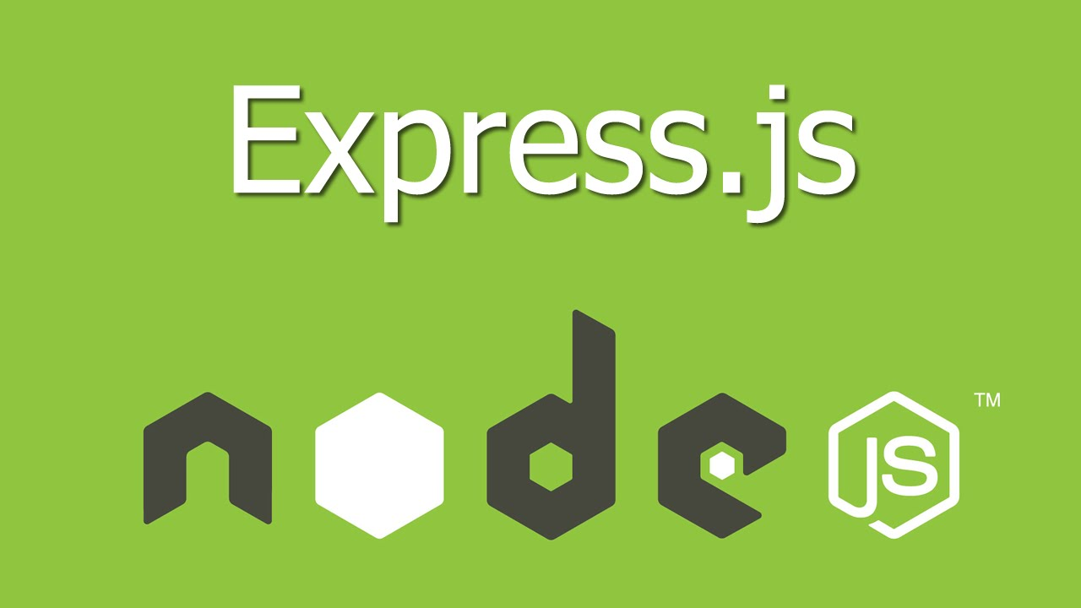
3.1 Installation Tool List 3.1.2 Back-end
3.1.2.2 Express.js
Open source SDK that enables developers to build mobile apps using web technologies
A framework that makes it easy to build a Web server
Can build web frameworks lightly and flexibly

Slide 11

3.1 Installation Tool List 3.1.2 Back-end
3.1.2.3 MongoDB
Store data in flexible, JSON-like documents
Distributed database at its core, so easy to use

Slide 12
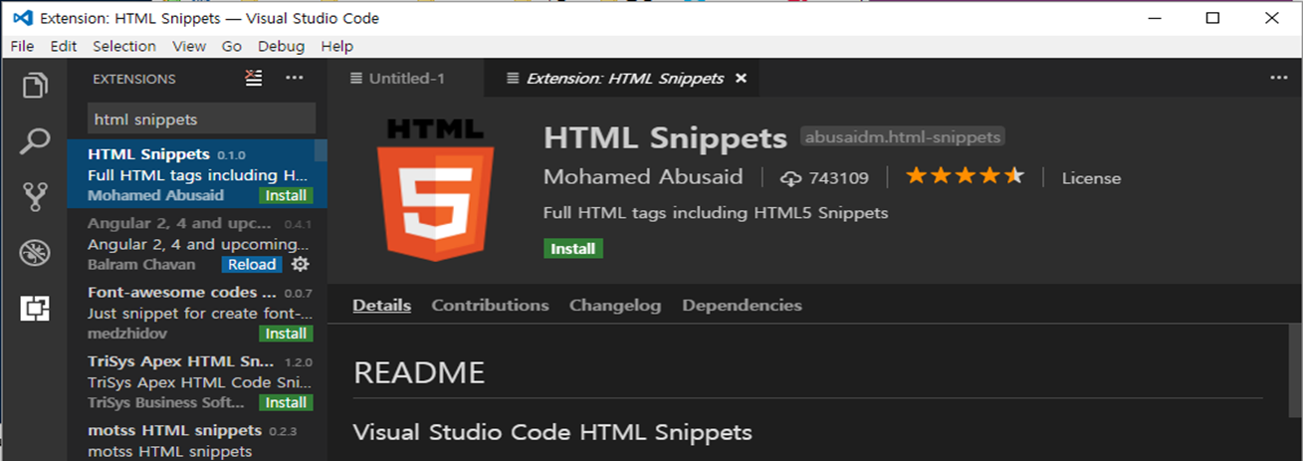
3.2 Visual Studio Code
3.2.1 HTML Snippets
Install VS Code extension program

Slide 13
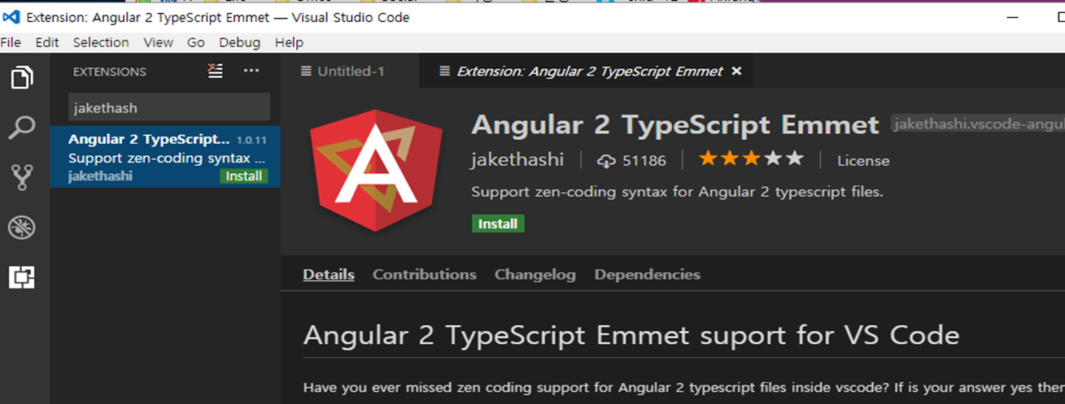
3.2 Visual Studio Code
3.2.2 Angular 2 TypeScript Emmet
Install VS Code extension program

Slide 14
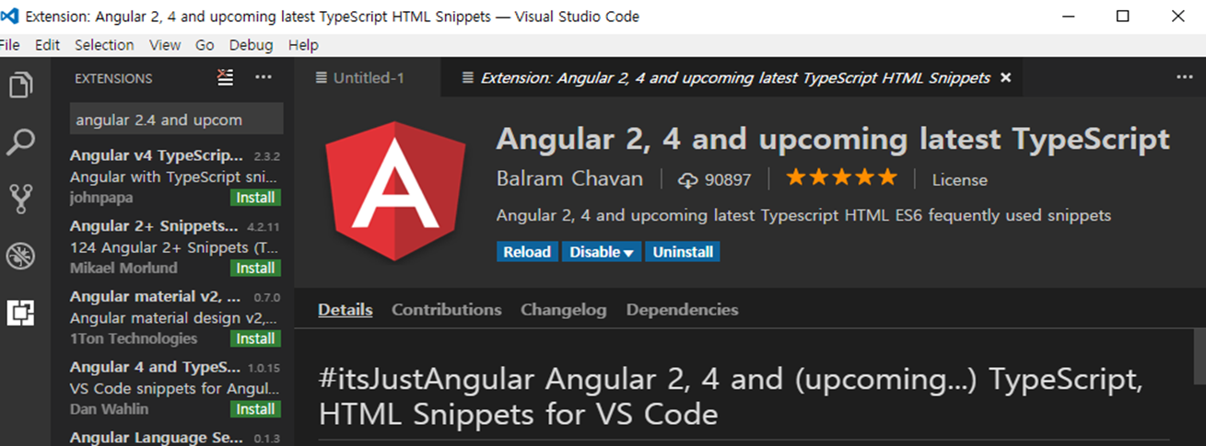
3.2 Visual Studio Code
3.2.3 Angular 2, 4 upcoming latest TypeScript HTML Snippets
Install VS Code extension program

Slide 15
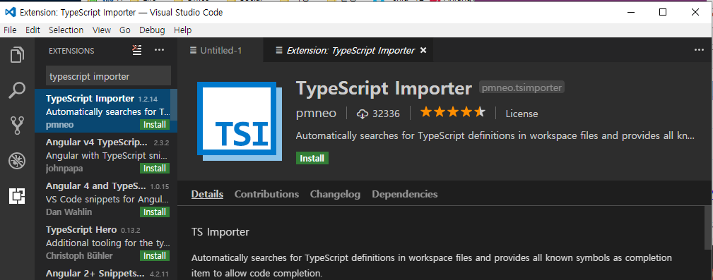
3.2 Visual Studio Code
3.2.4 TypeScript Importer
Install VS Code extension program

Slide 16
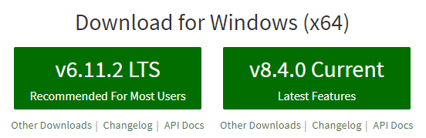
3.3 Back-end Tool installation
3.3.1 Node.js
Install Node.js from the Node.js homepage
http://nodejs.org

Slide 17

3.3 Back-end Tool installation
3.3.1 Node.js
In the cmd window, type “node –v”

Slide 18

3.3 Back-end Tool installation
3.3.1 Node.js
Enter “npm –v” to check the npm version

Slide 19
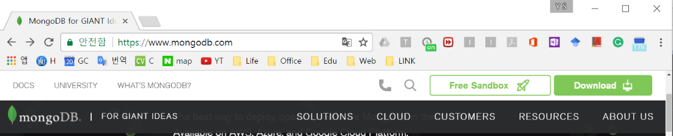
3.3 Back-end Tool installation
3.3.2 MongoDB
Go to mongoDB homepage and install mongoDB
http://www.mongodb.com

Slide 20
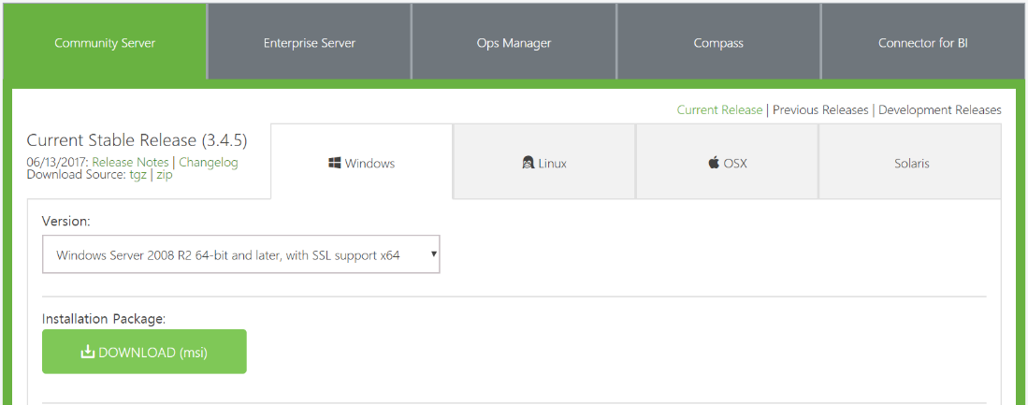
3.3 Back-end Tool installation
3.3.2 MongoDB
Download and install

Slide 21

3.3 Back-end Tool installation
3.3.2 MongoDB
Create new folder which name is mongodb on your desktop to store the data
Run mongoDB
Go to bin folder and run cmd
Run mongoDB with command “mongod --dbpath C:\Desktop\mongodb”
mongodb is specified path name of new folder to store data

Slide 22
3.4 Front-end Tool Installation
3.4.1 Ionic Framework (CLI and CORDOVA)
Create a folder named server on your desktop
Open VS code in server folder
Install CLI and CORDOVA to create ionic project with “npm install –g ionic cordova”

Slide 23
3.5 Testing
3.5.1 Creating Ionic Project
Create project with “ionic start museum tabs”
museum is project name, and tabs is template

Slide 24
3.5 Testing
3.5.1 Creating Ionic Project
Go to the project with “cd museum”

Slide 25
3.5 Testing
3.5.1 Creating Ionic Project
Start the project and preview it in a browser with “ionic serve” command

Slide 26
3.5 Testing
3.5.2 Creating Node Server
Open the VS Code in the server folder which is located on your desktop and open the terminal with “ctrl + `”
Install express module using “npm install express-generator –g”

Slide 27
3.5 Testing
3.5.2 Creating Node Server
Create a project with “express –e example”
example is project name
Move to project with “cd example” command

Slide 28
3.5 Testing
3.5.2 Creating Node Server
Install package json module with “npm install”

Slide 29
3.5 Testing
3.5.2 Creating Node Server
Install mongoDB npm module for Node.js with “npm install mongojs --save"

Slide 30
3.5 Testing
3.5.2 Creating Node Server
Write the code below to a file that will be used to mongoDB
var mongo = require('mongojs’);
var collection = mongo('collection',['document'])

Slide 31
3.5 Testing
3.5.2 Creating Node Server
Run the server using the “npm start” command

Slide 32
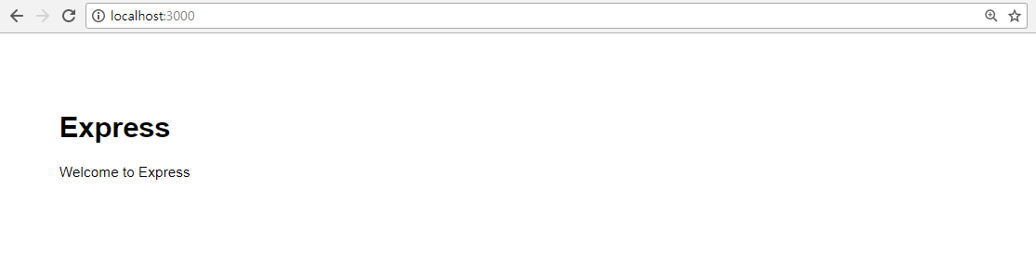
3.5 Testing
3.5.2 Creating Node Server
In a web browser, enter “http://localhost:3000” in the address bar to check whether the server is running well

Slide 33
Summary
We learned about the front-end and back-end installation tools we need to develop Ionic apps
We installed the tool
We have created an ionic project and a node server and launched it on a web browser

